Slide 1
NAVIGATION SYSTEM USING LIGHT-FIDELITY
Project Guide
Dr m.a.bhagyaveni
PRESENTED BY
MOHAMED YOOSUF I - 2018105030
SURIYA R -2018105064
BHARATHWAJ M -2018105515
GUNALAN S -2018105533
TEAM ID:
26-PWB2B322

Slide 2
OBJECTIVE :
During night time,due to lack of visibility and non- functioning of GPS, travellers to remote areas face difficulties in finding the correct path.
The project deals with the implementation of a LIGHT FIDELITY based module for NAVIGATION SYSTEM.
LED Lamp-posts can be used as the Li-Fi transmitter to supply travelers with current location at that moment and further divergences ahead to the receiver installed in the vehicles.

Slide 3
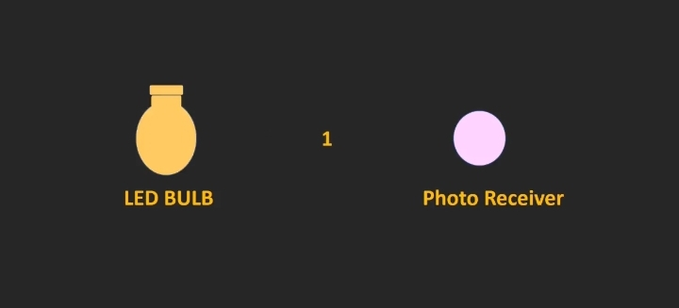
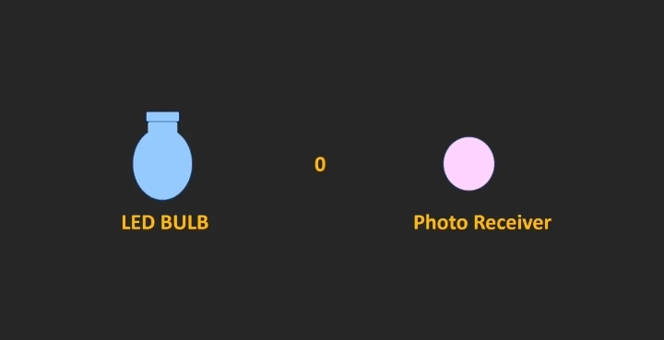
LIGHT FIDELITY :
LI-FI – “LIGHT FIDELITY” is the transmission of data through illumination I.e., sending data through a LED light bulb that varies in intensity faster than human eyes can follow.
PRINCIPLE OF OPERATION :

Slide 4
INTRODUCTION
We already designed the transmitter part with single LED lamp.
Now, we have designed the next part of our project i.e receiver section and added two LED lamp posts to the transmitter.
In receiver section,solar panel receives the light as 0s and 1s and location is displayed in the LCD.
Audio module is also included in the receiver section in order to tell the location via voice.

Slide 5
BLOCK DIAGRAM :
REGULATED POWER SUPPLY
BUCK CONVERTER
ARDUINO NANO
LED LAMP- POST
LIGHT
TRANSMITTER SECTION
ARDUINO NANO
OPERATIONAL AMPLIFIER
LCD DISPLAY
SOLAR PANEL
AUDIO MODULE
BUCK CONVERTER
REGULATED POWER SUPPLY
RECEIVER SECTION

Slide 6
HARDWARE COMPONENTS
TRANSMITTER
1.Arduino Nano
2.TIP122 x 3 + 100ohm Resistor x 3
3.PCB Board x 1
4. LED 12V x 3
RECEIVER
1.DF Player Module x 1
2.PAM8403 x 1
3. USD Card
4. 10K POT x 2
5. Solar panel x 1
6.op-amp x 1
7. PCB Board x 1
8. Arduino nano

Slide 7
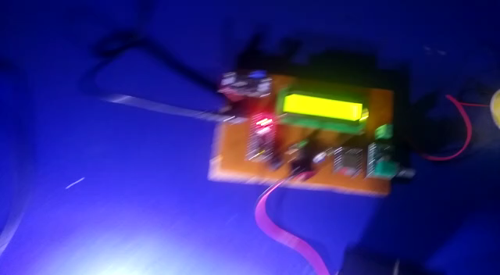
PROJECT DEMO VIDEO:

Slide 8
Project Workflow
1st review
Implemented transmitter section.
2nd review
Implemented receiver section.

Slide 9
conclusion:
This project will present a Navigation system using lifi which Helps to find the current location and further diversions during night time.It will help the people for navigation while the internet is not available.So LED lamp posts are used for both the illumination and navigation purposes.

Slide 10
LITERATURE SURVEY:
S.NO | AUTHOR NAME | TITLE | CONTENT | INFERENCE
1 | M.THANIGAVEL M .TECH CSE DEPT VOL. 2 ISSUE 10, OCTOBER - 2013 | LIFI TECHNOLOGY USING WIRELESS COMMUNICATION | COMPARISON OF BLUETOOTH, WI-FI & LI-FI. | LEARNED THE WORKING OF LIFI
2 | MAIDEEN ABDHULKADER JEYLANI,ACHUTHAN B,ARUN KUMAR B,CHIRAGSUN RL (2021) | UNDERWATER WIRELESS COMMUNICATION USING LI-FI | LIFI TRANSMITTER AND RECEIVER MODULE | LEARNED ABOUT THE TRANSMITTER SECTION
3 | D. SINGH, A. SOOD, G. THAKUR, N. ARORA AND A. KUMAR (2017) | DESIGN AND IMPLEMENTATION OF WIRELESS COMMUNICATION SYSTEM FOR TOLL COLLECTION USING LIFI | EXPLANATION OF THE COMPONENTS | UNDERSTANDING THE USAGE OF COMPONENTS

Slide 11
REFERENCE
1. M. THANIGAVEL “Li-Fi Technology in Wireless Communication”, International Journal of Engineering Research & Technology, Vol. 2 Issue October 10, 2013.
2. MAIDEEN ABDHULKADER JEYLANI,ACHUTHAN B,ARUN KUMAR B,CHIRAGSUN RL"Underwater Communication Using Li-Fi," 2021 3rd International Conference on Signal Processing and Communication (ICPSC), 2021
3. D. SINGH, A. SOOD, G. THAKUR, N. ARORA AND A. KUMAR, "Design and implementation of wireless communication system for toll collection using LIFI," 2017 4th International Conference on Signal Processing, Computing and Control (ISPCC), 2017

Slide 12
THANK YOU

